Slide 1
Advanced Javascript
IPromises, async await

Slide 2
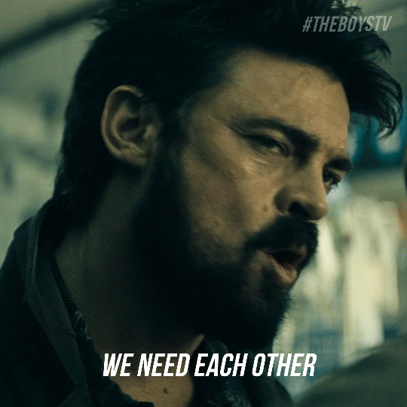

Slide 3
Before Promises there were Callbacks.

Slide 4

Promise
A promise is a commitment by someone to do or not do something

Slide 5
Why Promises in Js?
Sometimes a piece of code will take ‘x’ seconds to execute.
Depending on the it, we have other piece of code.
This other piece of code is dependent on first piece of code. So, it waits until first piece of code is done executing

Slide 6
Promises have consequences.
They will be fullfilled.
They will not be fullfilled.
They will be in the process.

Slide 7

Promise by nature, takes time to fulfill or not fulfill.
Basically, we have to WAIT.

Slide 8
In JS programming, We need asynchronous behaviour.

Slide 9
Promises are useful when we have to wait for return value and use that return value without interrupting anything else in our program.

Slide 10
JavaScript Promise Object

Slide 11
var promise = new Promise()

Slide 12
Resolve : When promise is fullfilled
Reject : When promise is rejected

Slide 13
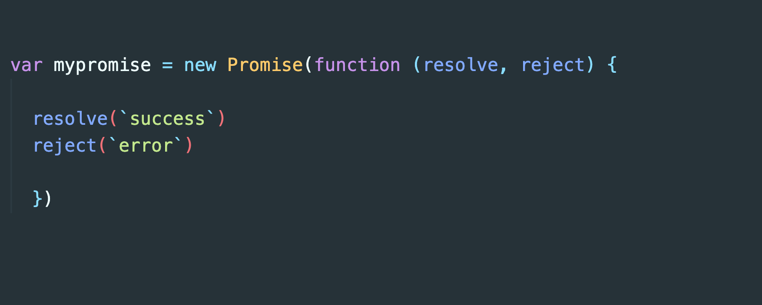
Resolve is the function that runs when promise is fullfiiled
Reject is the function that runs when promise is not fullfilled

Slide 14
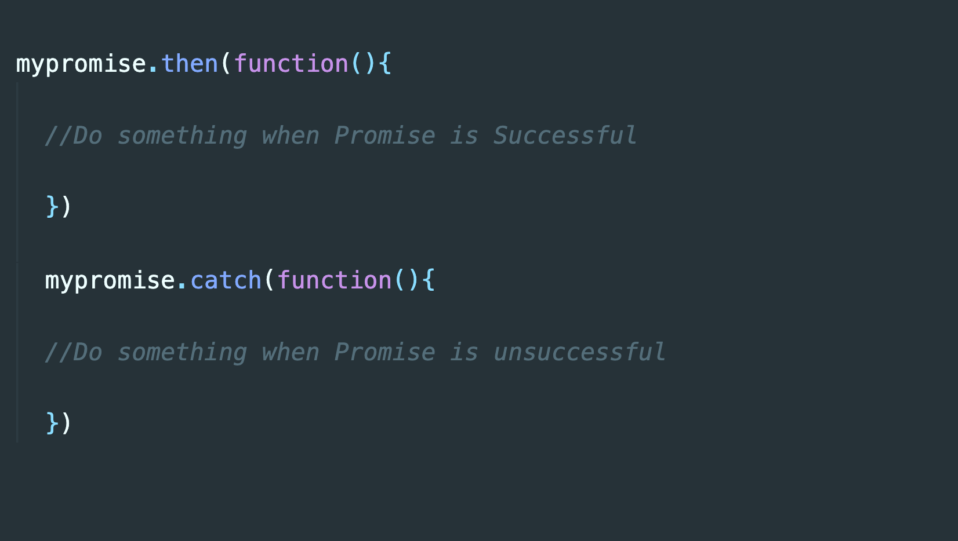

Slide 15
Async Await

Slide 16
It’s just a new and better way of writing promises.

Slide 17
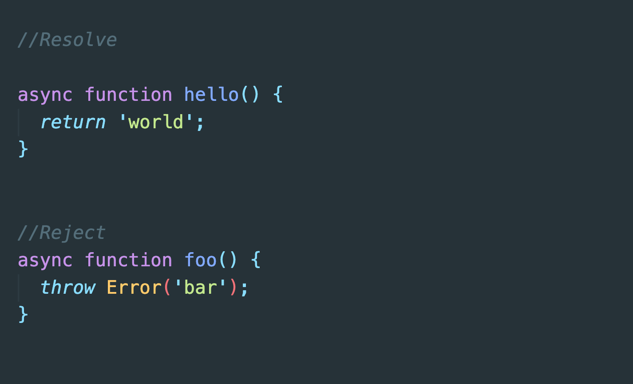

Slide 18
So, we are getting promise using new async keyword.

Slide 19
So, we are getting promise using new async keyword.
How do we get the Promise result?

Slide 20
Earlier, we got succesfull promise using, .then()
and unsuccesfull promise using .catch()

Slide 21
await

Slide 22
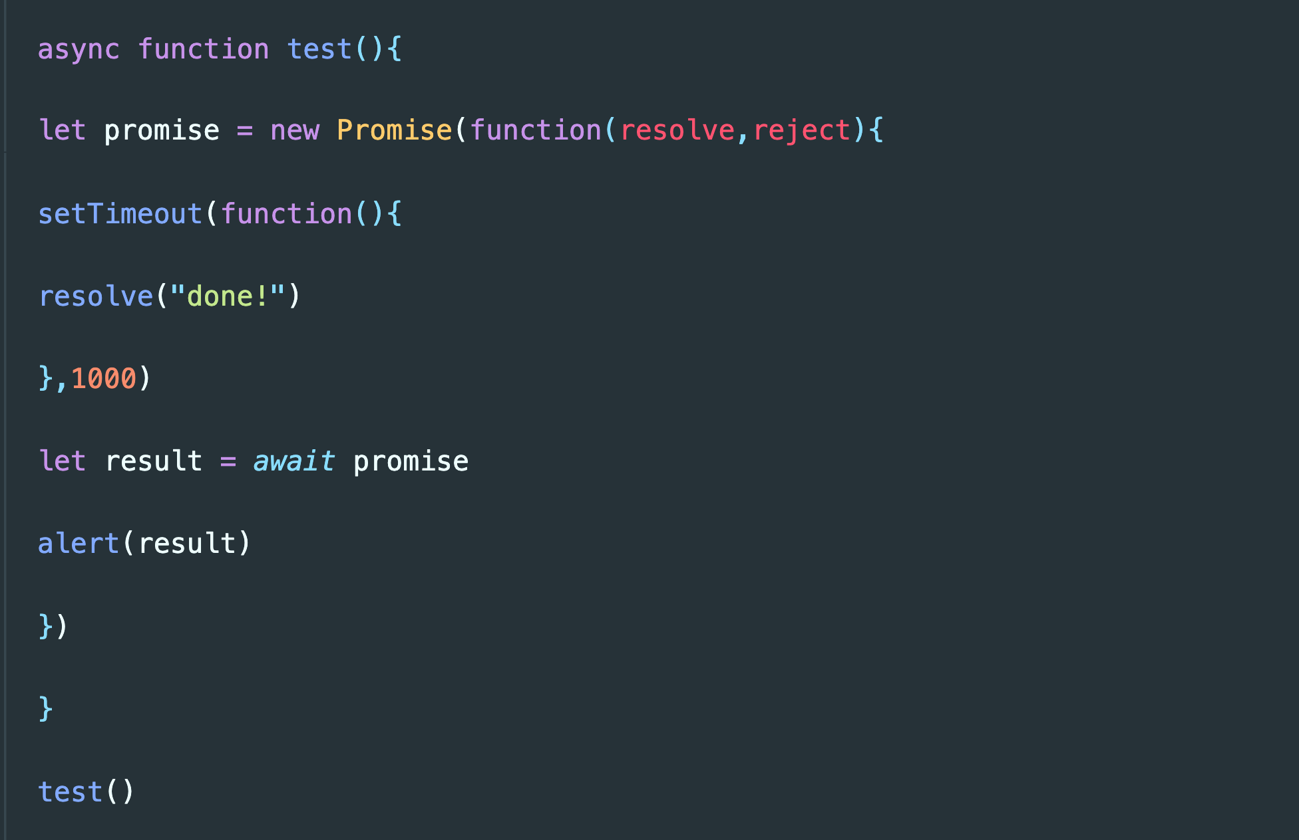

Slide 23
await literally suspends the function execution until the promise settles, and then resumes it with the promise result

